Slide 1



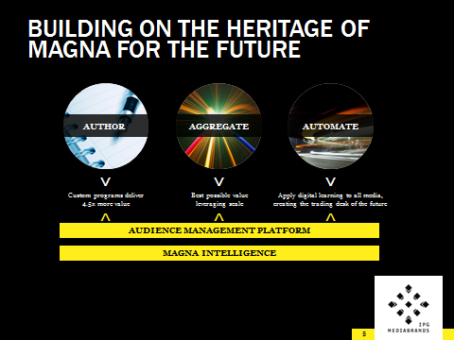


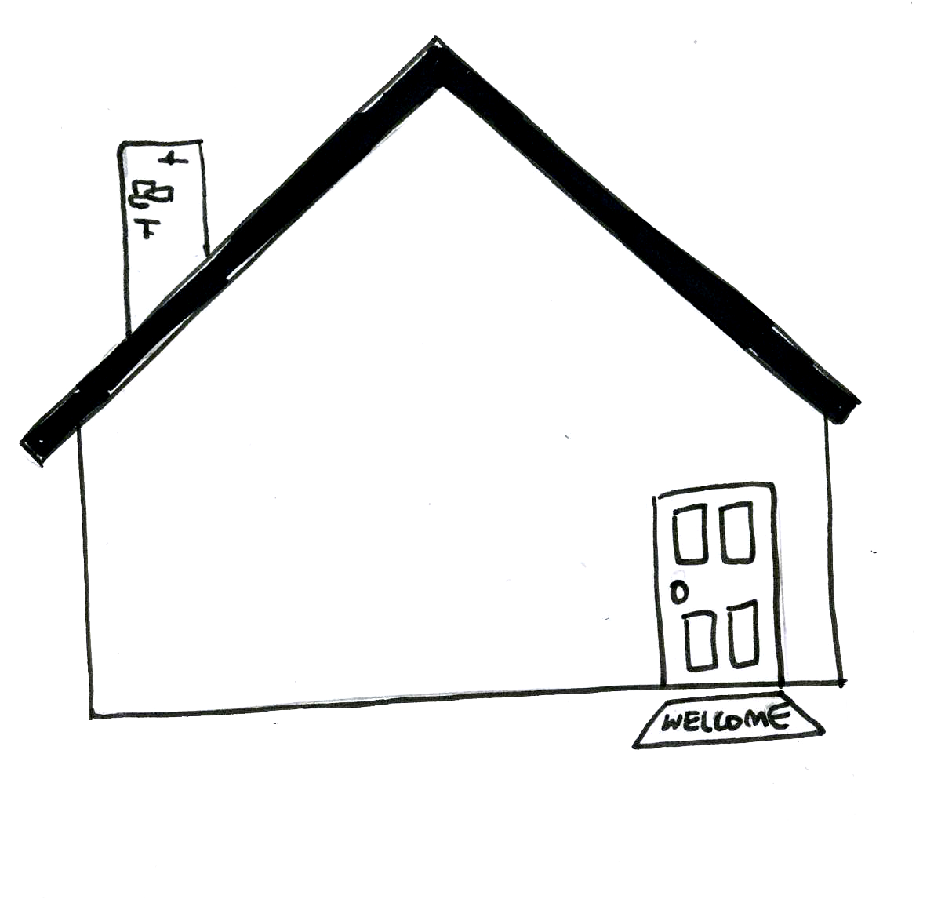

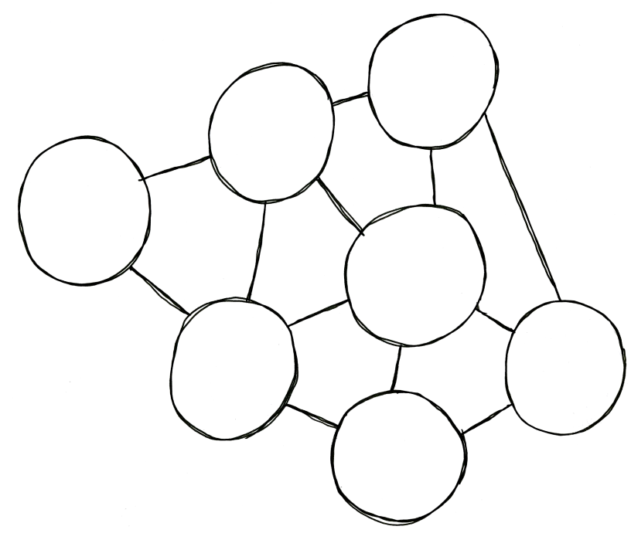



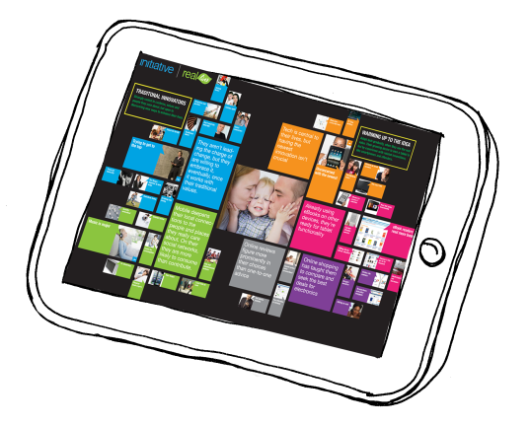





























Four core principles
A scalable worldwide network
Building toward the future
Recognized by our industry
Brandon -- Can we simplify this image into a graphic? all content on the next slide
6500 people
SILVER
Hasbro KRE-O Stop Motion Videos
127 markets
EFFIE GOLD
Kia Soul Takes on Scion Xb
& Nissan Cube
$35 billion
GOLD
Dr Pepper CHEGG Campaign
Supported by a powerful network
SILVER
Best Western “Travel Hero”
The right capabilities
INVESTMENT
DIGITAL
STRATEGY
Search
ANALYTICS
Mobile
Digital Ad Network
Intelligence
MEDIA
PLANNING
Barter
Direct
Innovation
Retail
Branded Content
INNOVATION
SOCIAL
Multicultural
Emerging/Technology
Thinktank
Social
The right experience
The right systems

Slide 2



Building on the heritage of MAGNA for the future
AUTHOR
AGGREGATE
AUTOMATE
⌃
⌃
⌃
Custom programs deliver 4.5x more value
Best possible value leveraging scale
Apply digital learning to all media, creating the trading desk of the future
⌃
⌃
⌃
AUDIENCE MANAGEMENT PLATFORM
MAGNA INTELLIGENCE
2

